Slide 1
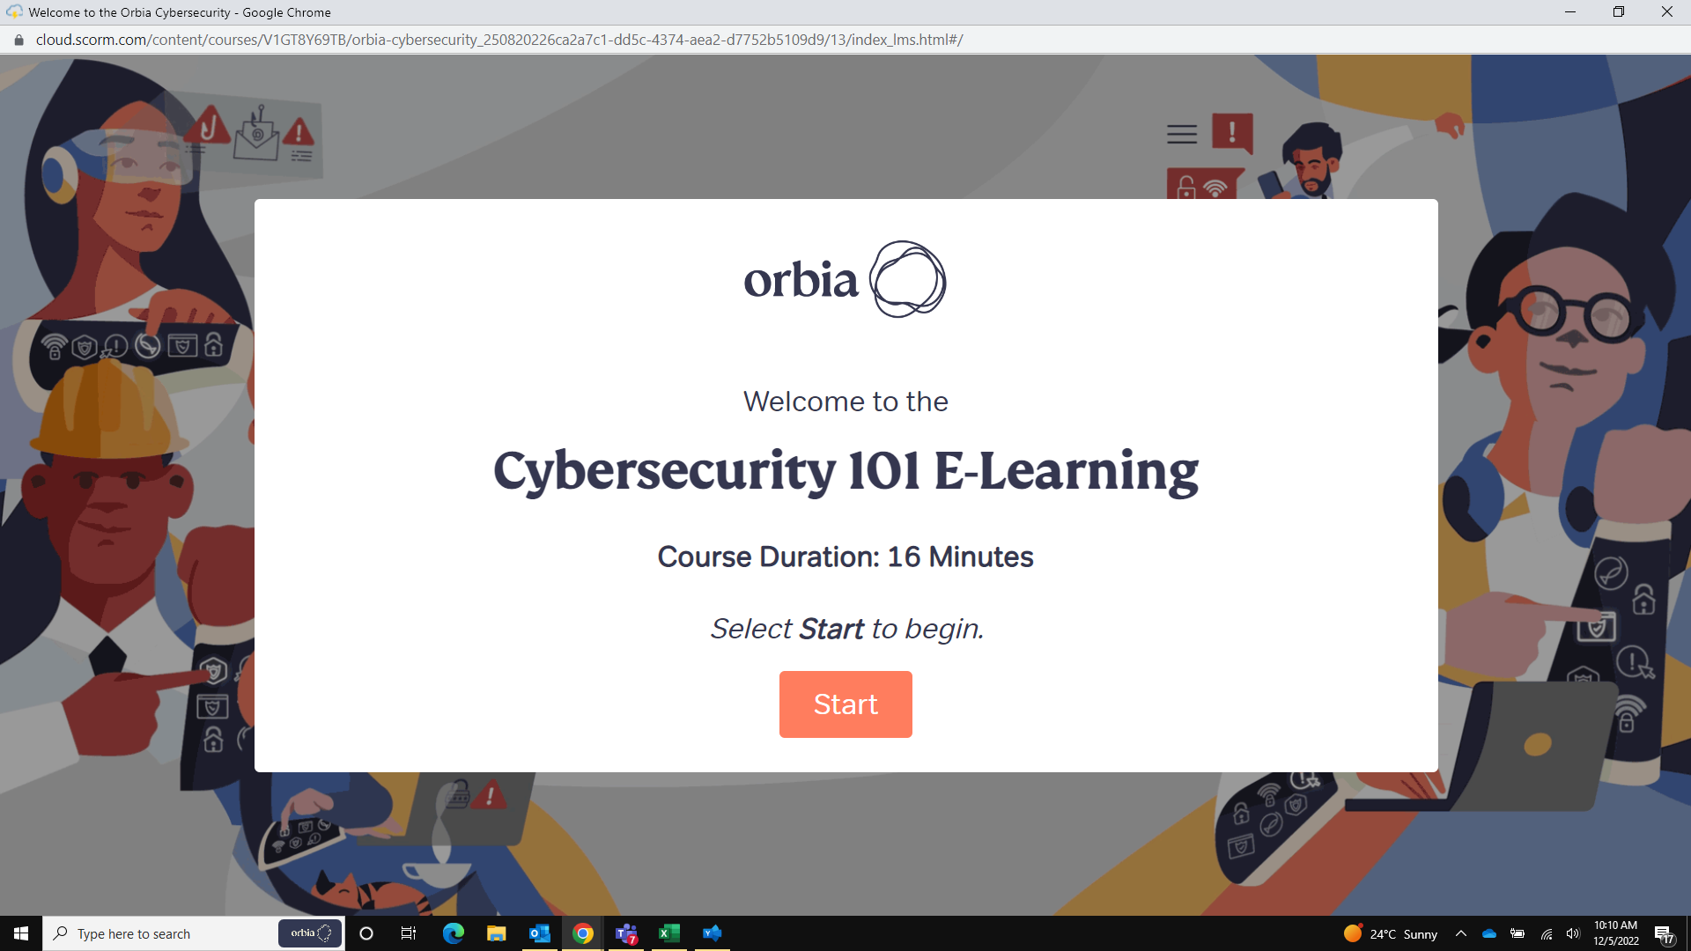
Notes:
Change course duration from 16 minutes to 18 minutes
Dev Comment : Done in zh-CN

Slide 2
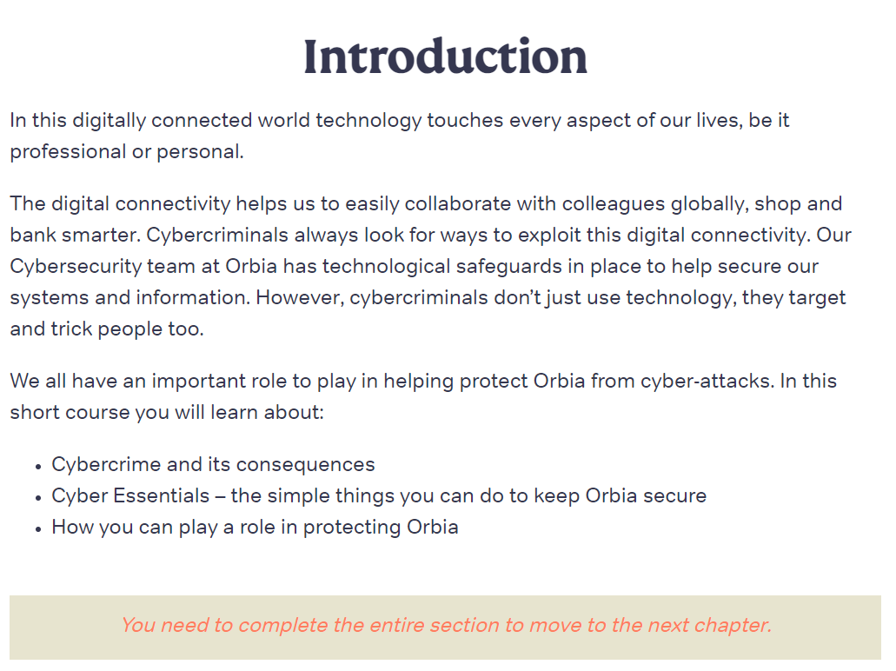
In this digitally connected world technology touches every aspect of our lives, be it professional or personal.
The digital connectivity helps us to easily collaborate with colleagues globally, shop and bank smarter. Cybercriminals always look for ways to exploit this digital connectivity. Our Cybersecurity team at Orbia has technological safeguards in place to help secure our systems and information. However, cybercriminals don’t just use technology, they target and trick people too.
We all have an important role to play in helping protect Orbia from cyber-attacks. In this short course you will learn about:
Cybercrime and its consequences
Cyber Essentials – the simple things you can do to keep Orbia secure
How you can play a role in protecting Orbia
You need to complete the entire section to move to the next chapter.
Notes:
Replace the highlighted text with –
“Cyber Essentials Toolkit – guides to assist with adopting secure cyber behaviors”
Dev Comment : Done in zh-CN

Slide 3
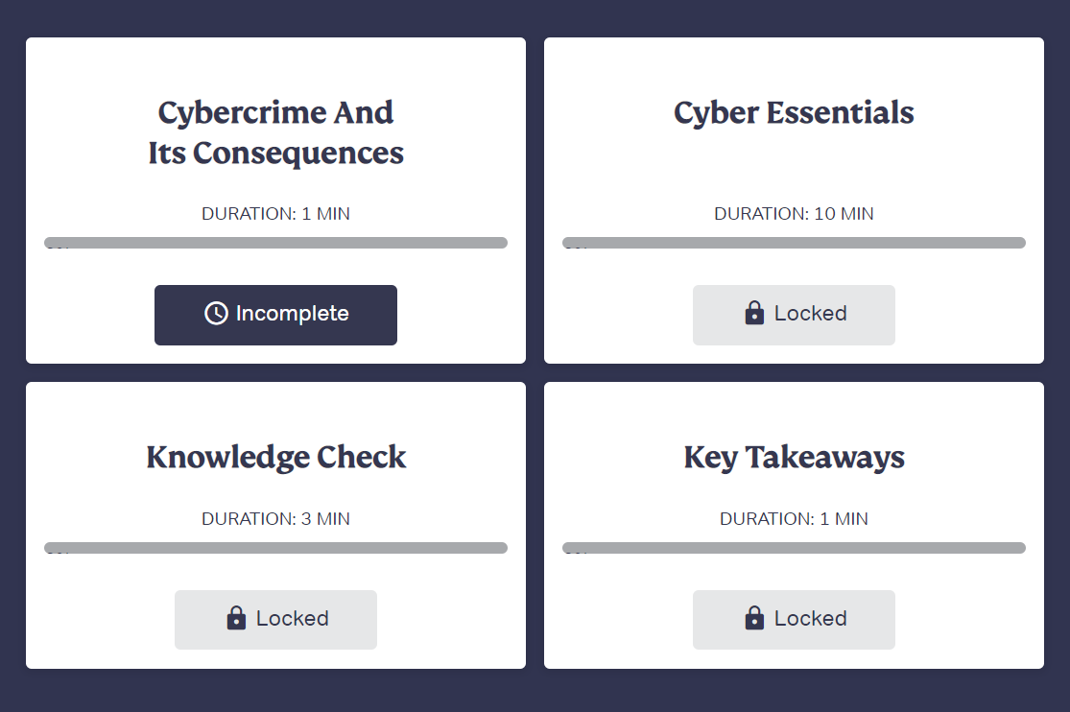
Notes:
Replace “Cyber Essentials” with “Cyber Essentials Toolkit”
Change duration minutes as below:
Cybercrime And Its Consequences 2 MIN
Cyber Essentials 12 MIN
Knowledge Check 3 MIN
Key Takeaways 1 MIN
Dev Comment : Done in zh-CN

Slide 4
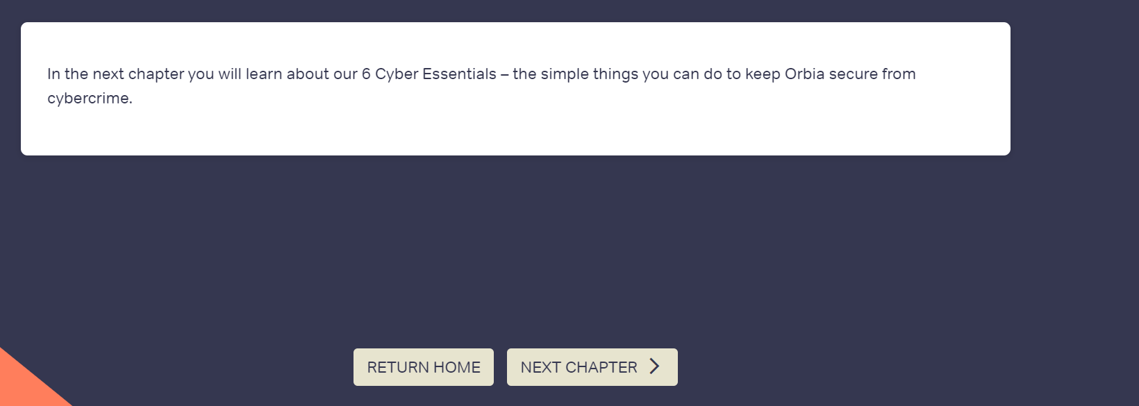
In the next chapter you will learn about our 6 Cyber Essentials – the simple things you can do to keep Orbia secure from cybercrime.
Notes:
Replace highlighted text with “In the next chapter you will learn about our Cyber Essentials Toolkit – guides to assist with adopting secure cyber behaviors.”
Dev Comment : Done in zh-CN

Slide 5

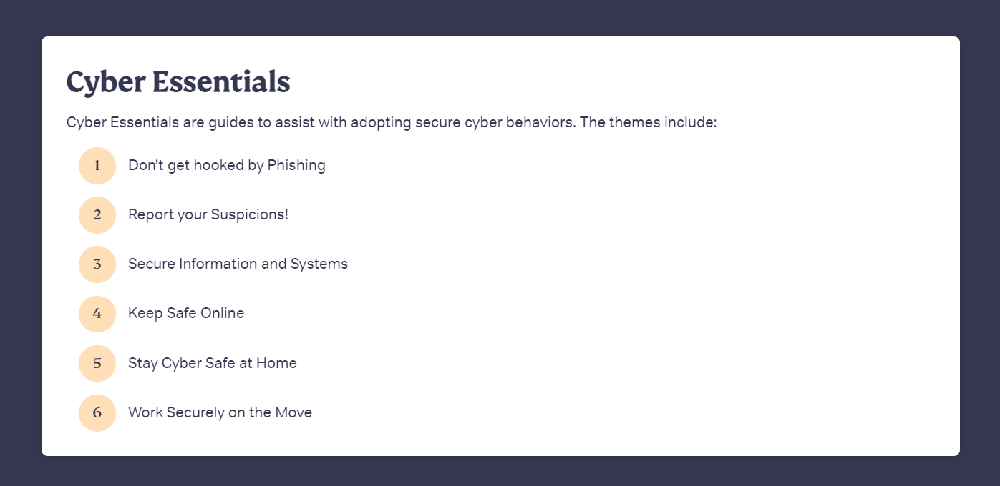
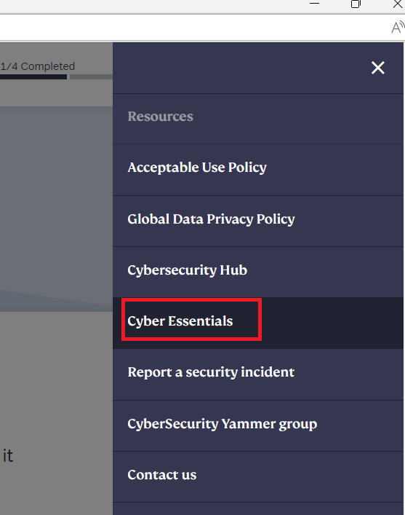
2
1
3
Notes:
Replace header with “Cyber Essentials Toolkit” for these 3 instances in the course.
Dev Comment : Done in zh-CN

Slide 6
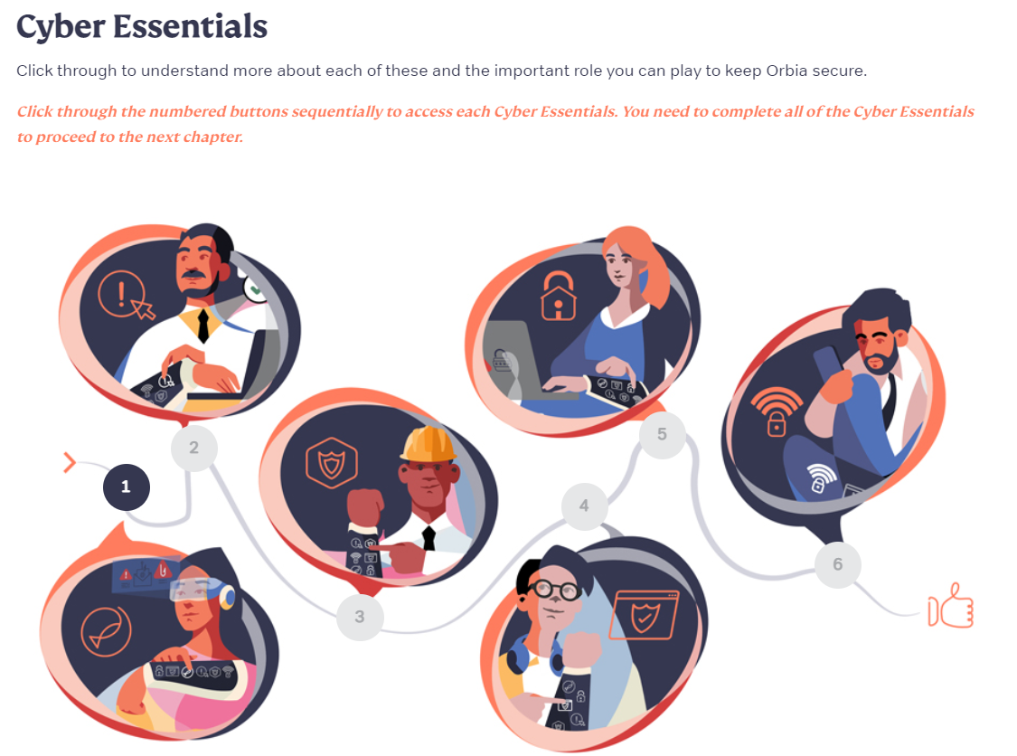
Cyber Essentials
Click through to understand more about each of these and the important role you can play to keep Orbia secure.
Click through the numbered buttons sequentially to access each Cyber Essentials. You need to complete all of the Cyber Essentials to proceed to the next chapter.
Notes:
Replace header with “Cyber Essentials Toolkit”
Dev Comment : Done in zh-CN

Slide 7
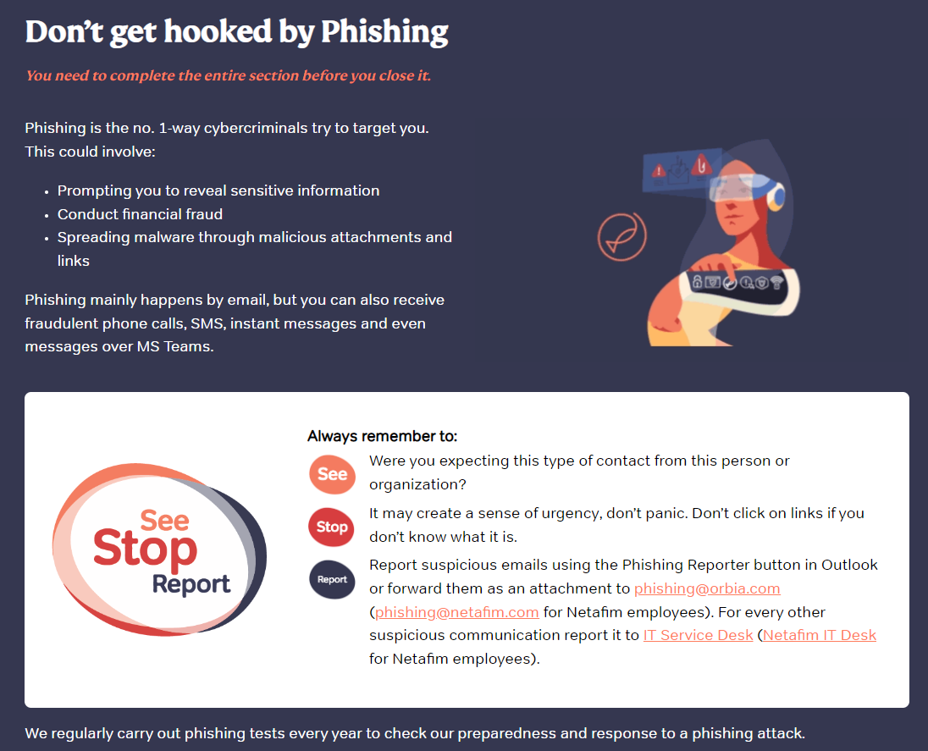
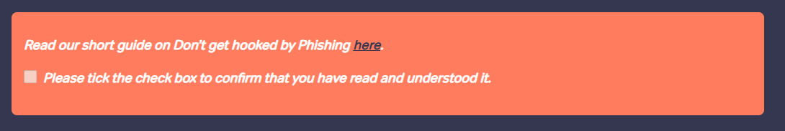
Don’t get hooked by Phishing
You need to complete the entire section before you close it.
Phishing is the no. 1-way cybercriminals try to target you. This could involve:
Prompting you to reveal sensitive information
Conduct financial fraud
Spreading malware through malicious attachments and links
Phishing mainly happens by email, but you can also receive fraudulent phone calls, SMS, instant messages and even messages over MS Teams.
Notes:
Remove section and amend the content in red highlighted box to “We conduct phishing tests regularly to understand your response to a phishing attack.”
Dev Comment : Done in zh-CN

Slide 8
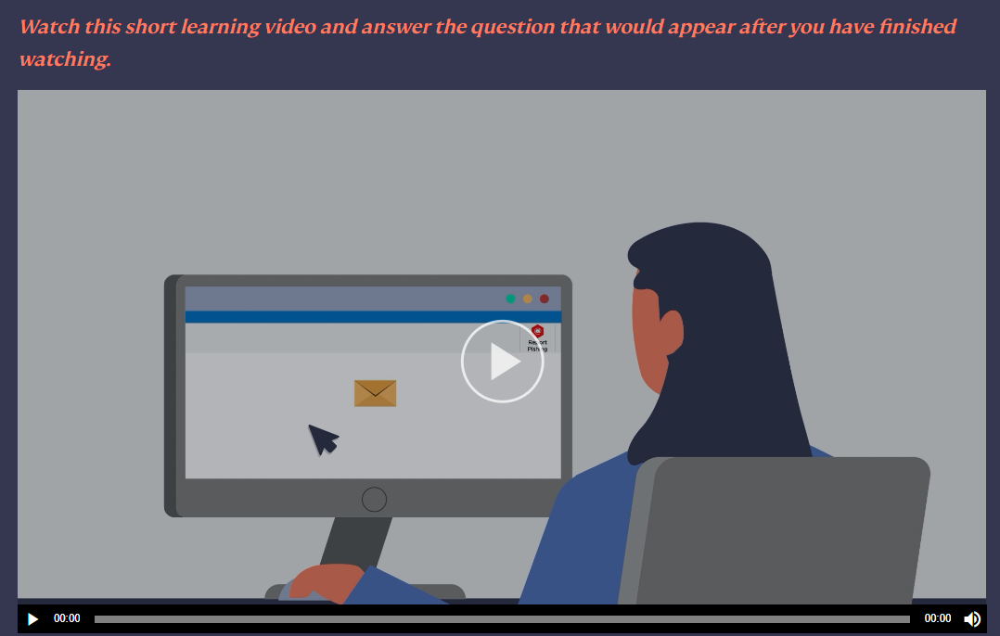
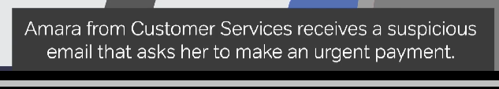
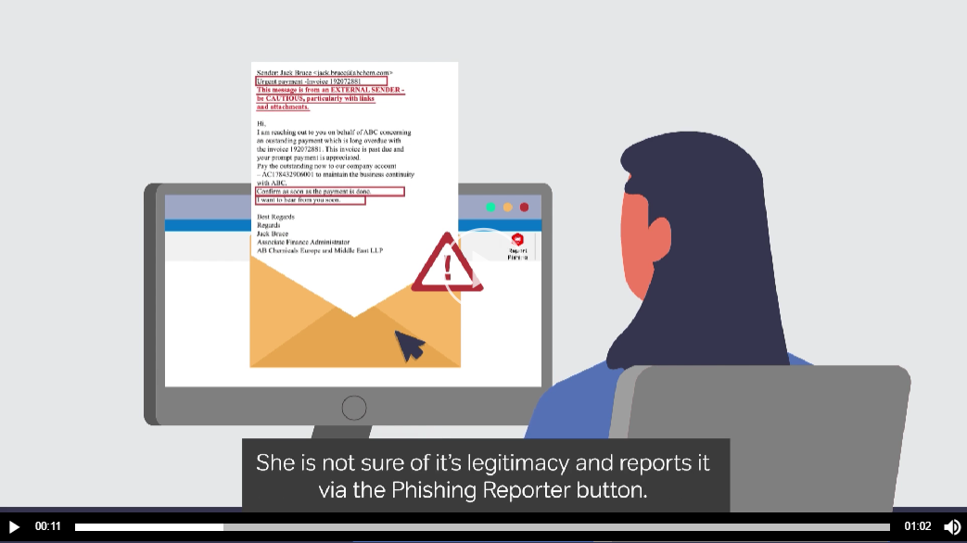
Notes:
From 00:10 to 00:14 Amara should click on reporting and
00:14 to 00:28 the security advice should show.
Dev Comment : Done in zh-CN

Slide 9
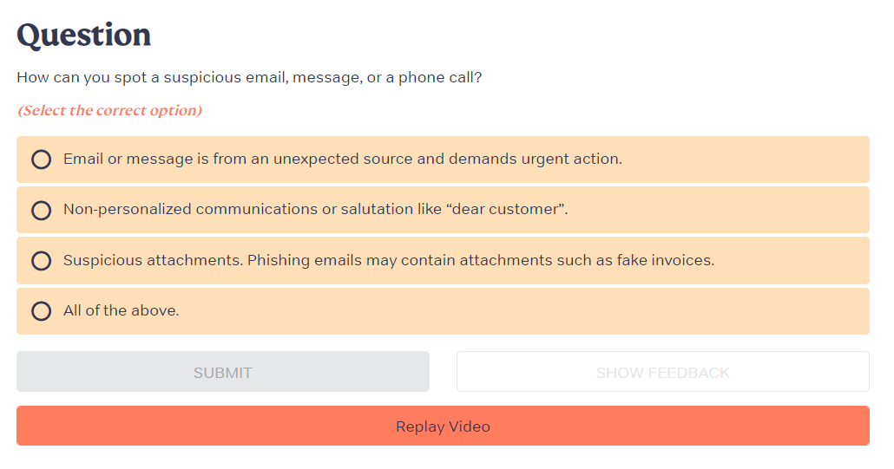
Question
How can you spot a suspicious email, message, or a phone call?
(Select the correct option)
Email or message is from an unexpected source and demands urgent action.
Non-personalized communications or salutation like “dear customer”.
Suspicious attachments. Phishing emails may contain attachments such as fake invoices.
All of the above.
Feedback
Partly correct.
Think: were you expecting this type of contact from this person or organization? Don’t click on links, open attachments, or share information if you don’t know what it is — even if it creates a sense of urgency. Cybersecurity is everyone’s responsibility. Report your suspicion using the Phishing Reporter button in Outlook. For every other suspicious communication, report it to IT Service Desk.
Feedback
Correct.
Think: were you expecting this type of contact from this person or organization? Don’t click on links, open attachments, or share information if you don’t know what it is — even if it creates a sense of urgency. Cybersecurity is everyone’s responsibility. Report your suspicion using the Phishing Reporter button in Outlook. For every other suspicious communication, report it to IT Service Desk.
Notes:
Replace highlighted text in the correct and partly correct feedback as “For every other suspicious communication, report it to the IT Service Desk.”
Dev Comment : Not Applicable.

Slide 10
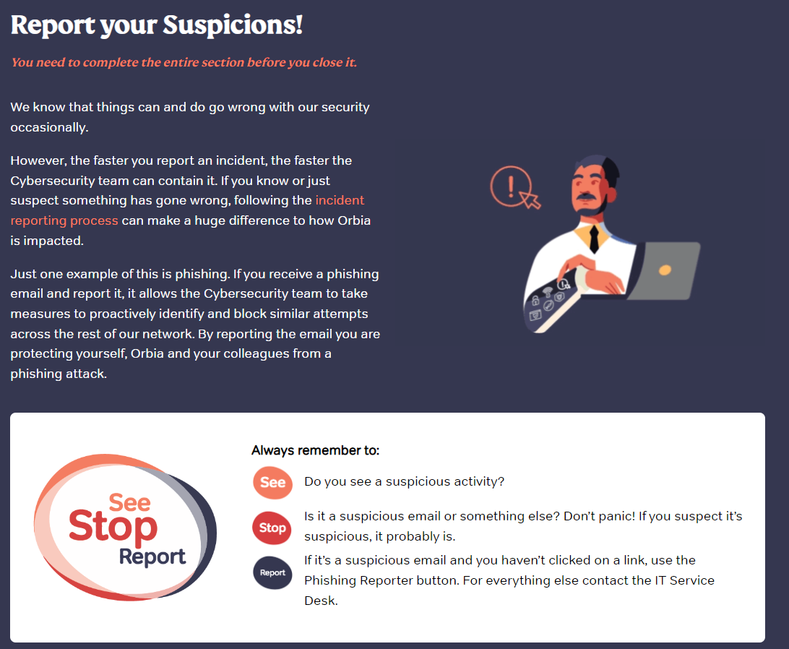
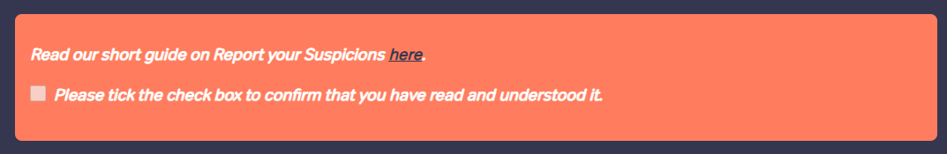
Report your Suspicions!
You need to complete the entire section before you close it.
We know that things can and do go wrong with our security occasionally.
However, the faster you report an incident, the faster the Cybersecurity team can contain it. If you know or just suspect something has gone wrong, following the incident reporting process can make a huge difference to how Orbia is impacted.
Just one example of this is phishing. If you receive a phishing email and report it, it allows the Cybersecurity team to take measures to proactively identify and block similar attempts across the rest of our network. By reporting the email you are protecting yourself, Orbia and your colleagues from a phishing attack.
Notes:
Remove section
Dev Comment : Done in zh-CN

Slide 11
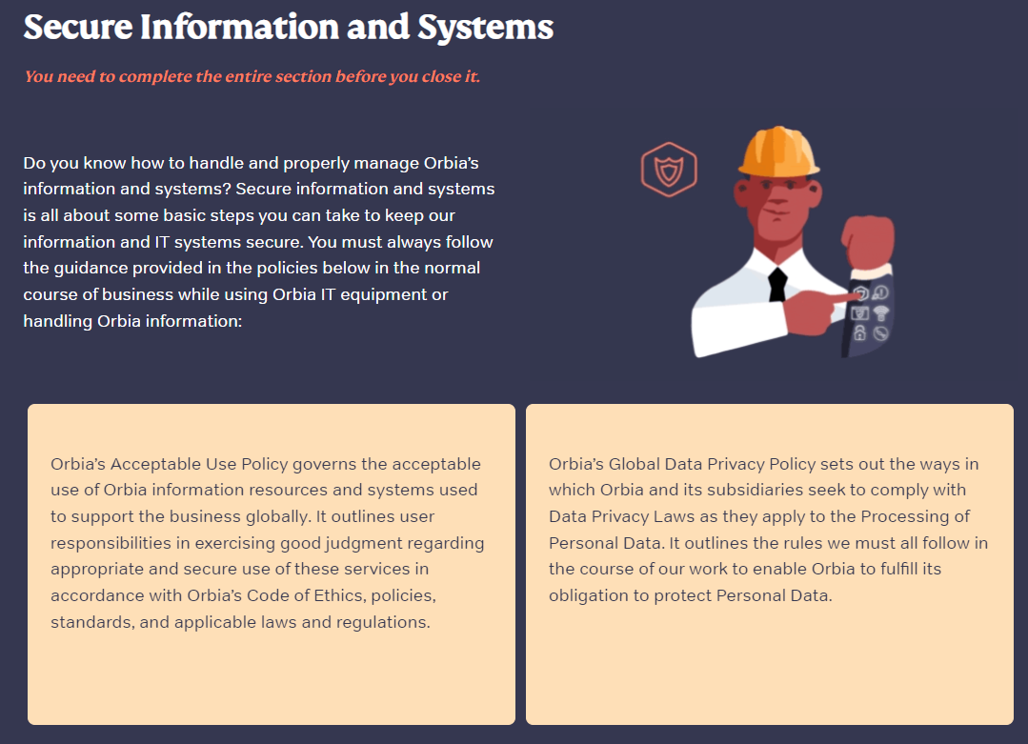
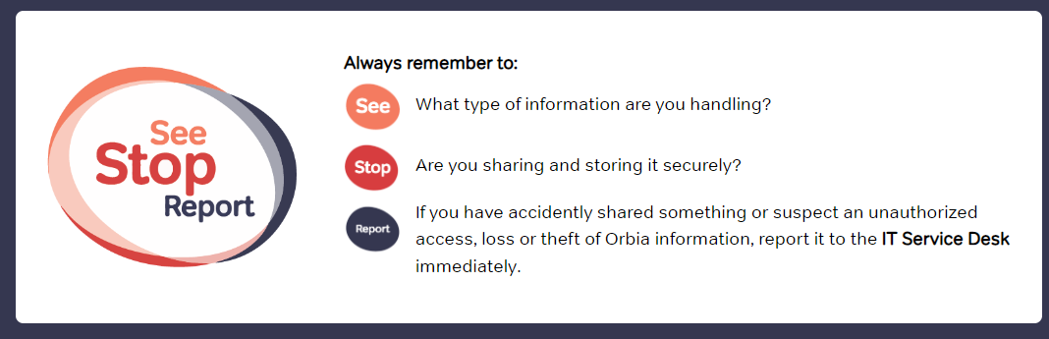
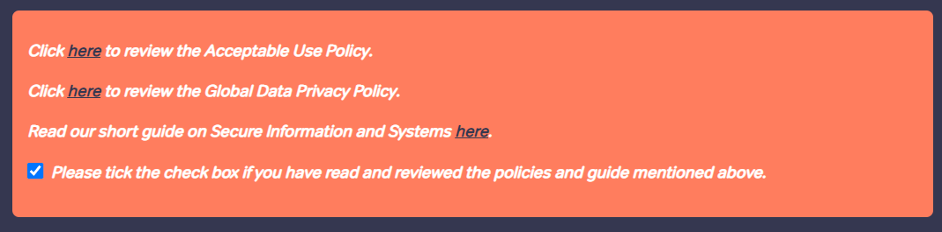
Secure Information and Systems
You need to complete the entire section before you close it.
Do you know how to handle and properly manage Orbia’s information and systems? Secure information and systems is all about some basic steps you can take to keep our information and IT systems secure. You must always follow the guidance provided in the policies below in the normal course of business while using Orbia IT equipment or handling Orbia information:
Orbia’s Acceptable Use Policy governs the acceptable use of Orbia information resources and systems used to support the business globally. It outlines user responsibilities in exercising good judgment regarding appropriate and secure use of these services in accordance with Orbia’s Code of Ethics, policies, standards, and applicable laws and regulations.
Orbia’s Global Data Privacy Policy sets out the ways in which Orbia and its subsidiaries seek to comply with Data Privacy Laws as they apply to the Processing of Personal Data. It outlines the rules we must all follow in the course of our work to enable Orbia to fulfill its obligation to protect Personal Data.
Notes:
Dev Comment : Done in zh-CN

Slide 12
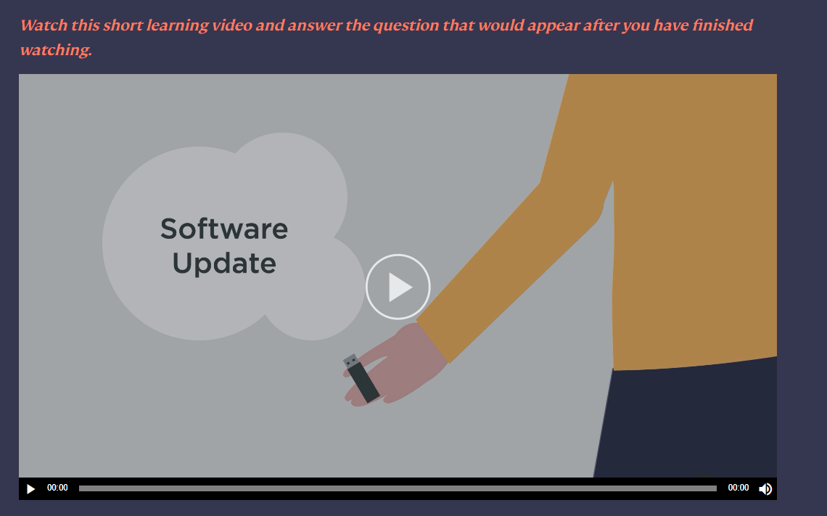
Notes:
Secure Information video: Change background music to something decent. Currently very upbeat.
Dev Comment : Done in zh-CN

Slide 13
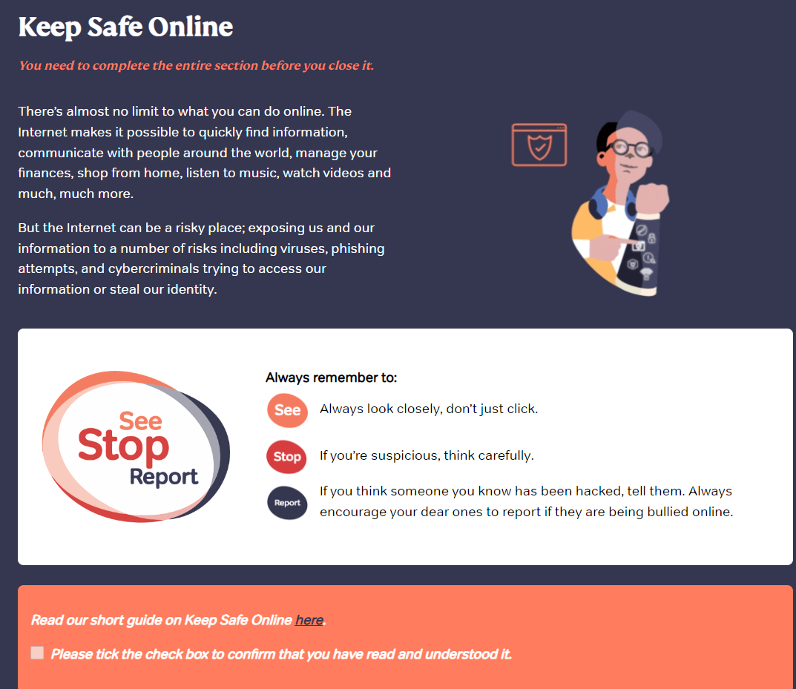
Keep Safe Online
Video scenario
You need to complete the entire section before you close it.
There’s almost no limit to what you can do online. The Internet makes it possible to quickly find information, communicate with people around the world, manage your finances, shop from home, listen to music, watch videos and much, much more.
But the Internet can be a risky place; exposing us and our information to a number of risks including viruses, phishing attempts, and cybercriminals trying to access our information or steal our identity.
Notes:
Remove section
Dev Comment : Done in zh-CN

Slide 14
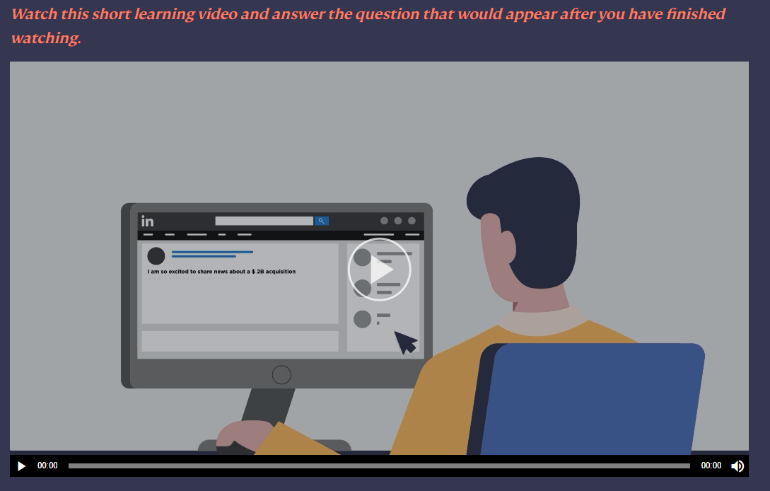
Notes:
Keep Safe online video: Change background music to something decent. Currently very upbeat.
Dev Comment : Done in zh-CN

Slide 15
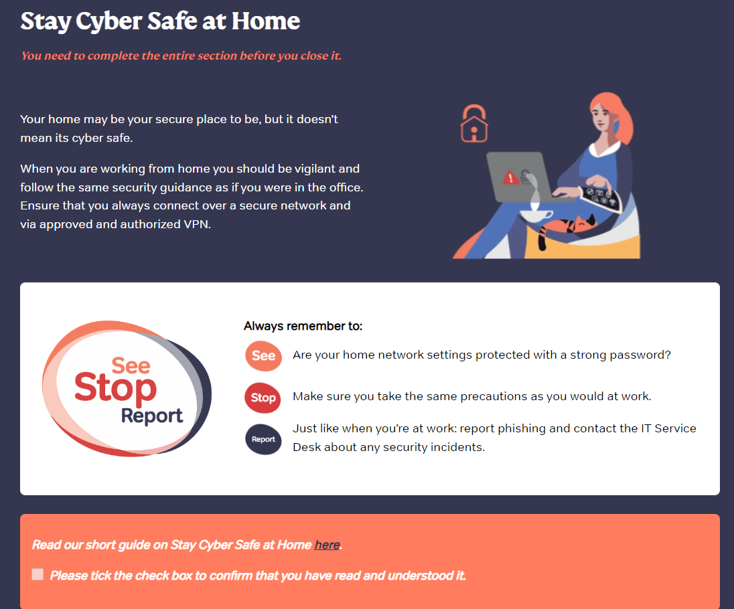
Stay Cyber Safe at Home
You need to complete the entire section before you close it.
Your home may be your secure place to be, but it doesn’t mean its cyber safe.
When you are working from home you should be vigilant and follow the same security guidance as if you were in the office. Ensure that you always connect over a secure network and via approved and authorized VPN.
Notes:
Remove section
Dev Comment : Done in zh-CN

Slide 16
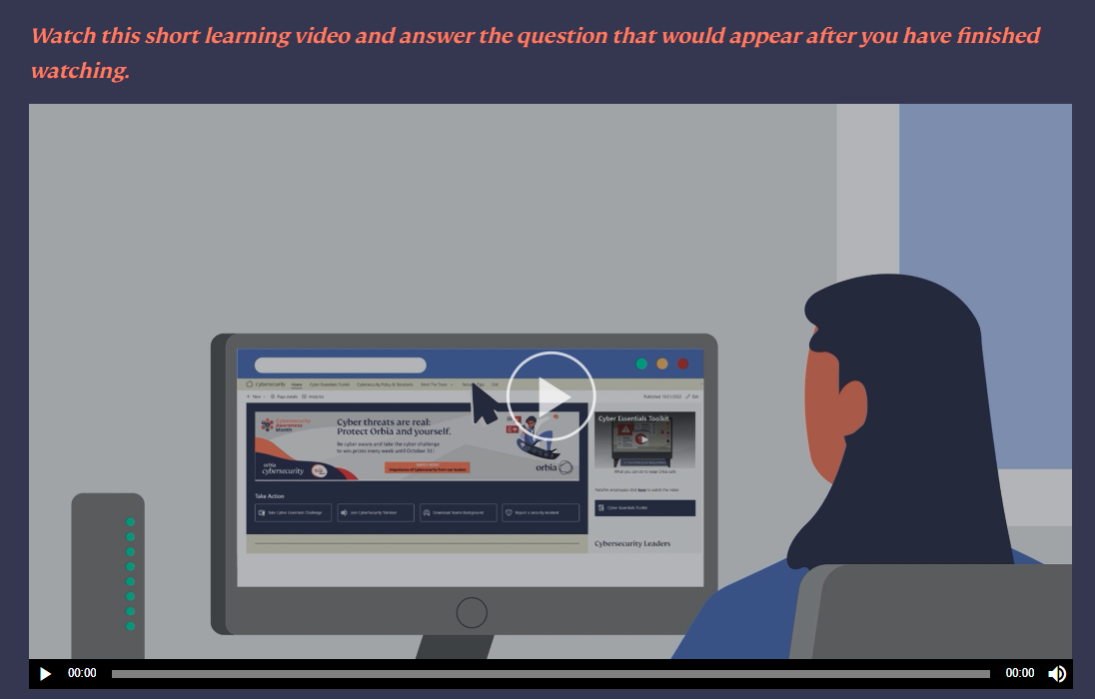
Notes:
Stay Cyber safe video: 00.24 to 00:32 subtitle content reading time is less. Please increase duration
Dev Comment : Done in zh-CN

Slide 17
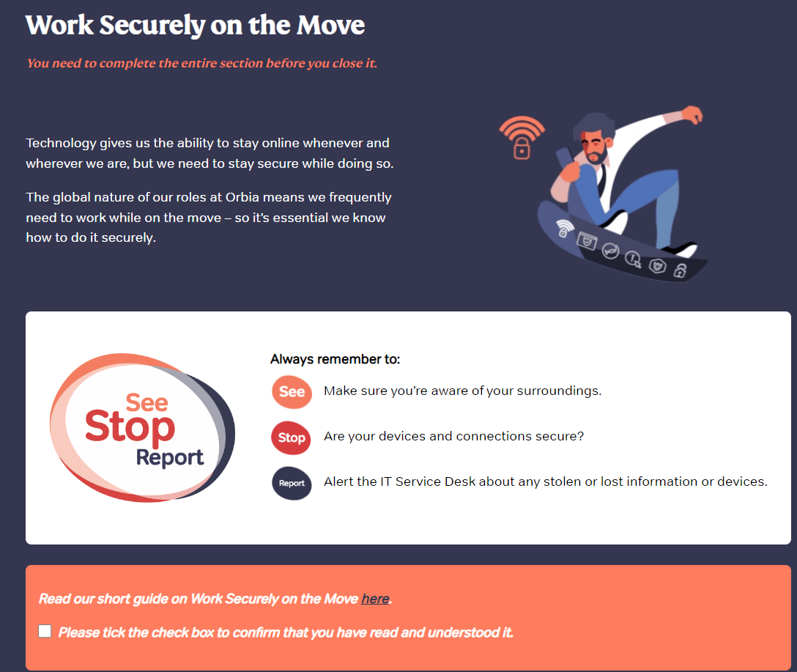
Work Securely on the Move
You need to complete the entire section before you close it.
Technology gives us the ability to stay online whenever and wherever we are, but we need to stay secure while doing so.
The global nature of our roles at Orbia means we frequently need to work while on the move – so it’s essential we know how to do it securely.
Notes:
Remove section
Dev Comment : Done in zh-CN

Slide 18
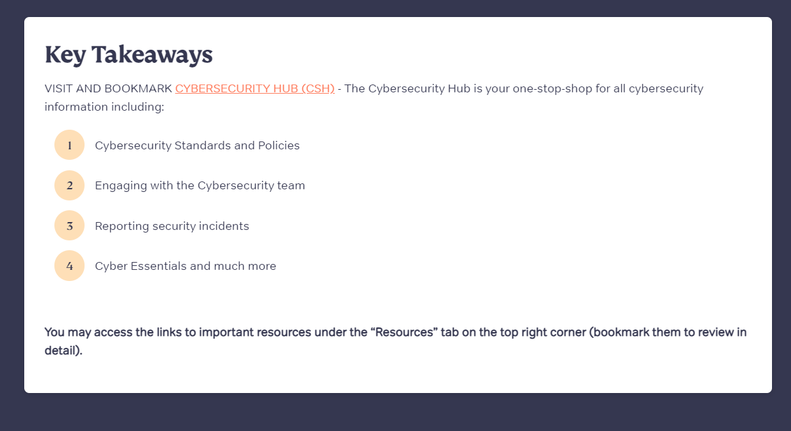
Key Takeaways
VISIT AND BOOKMARK CYBERSECURITY HUB (CSH) - The Cybersecurity Hub is your one-stop-shop for all cybersecurity information including:
Cybersecurity Standards and Policies
Engaging with the Cybersecurity team
Reporting security incidents
Cyber Essentials and much more
Completed
You may access the links to important resources under the “Resources” tab on the top right corner (bookmark them to review in detail).
Notes:
Remove “(CSH)”
Replace “Cyber Essentials and much more” with “Cyber Essentials Toolkit and much more”
Dev Comment : Done in zh-CN

